Slide 1

Dance with MySQL
Manage MySQL with Open source
周振兴@Taobao DBA
2010-06
1

Slide 2

What MySQL do for us
System A
950G data
650G index
Total 1.6T
IOPS 18947
Delta 3.2G
8000*1024 = 800W

Slide 3
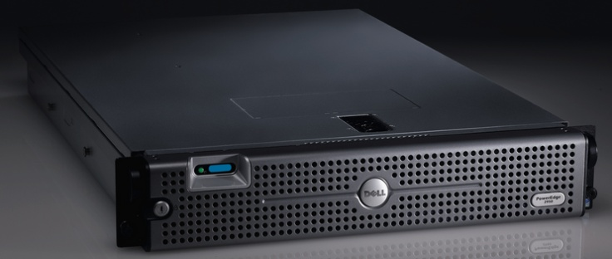
What MySQL do for us
System B
15,0000,0000 records
Total:4T
Delta
1000,0000
16 *
Uptime:217 days 18 hours 34 min 2 sec

Slide 4
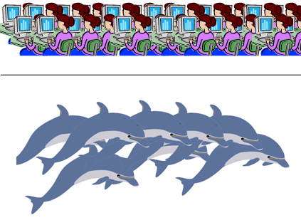
What about my topic
How to manage 200+ MySQL Instance

Slide 5



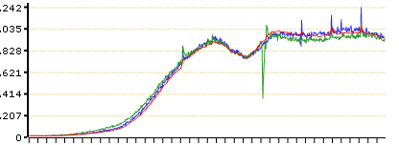
What we do
Test
routine Install
Find Problem/debug
Backup
Monitor

Slide 6
Why
Why we think about this a lot?
We have 200+ MySQL Instance
Test is about Money
Install is about Time
Debug is about Stability
Backup is about Safety
Monitor is about Status
Which one you can drop?

Slide 7
Why Test
Simple math
Performance increase 10%
200*2W *10% = 40W
200*2W *20% = 80W
What can 80W do ?

Slide 8
Why Test
Performance
Stable
Last year >85% accident can be avoided
This year < 5%

Slide 9
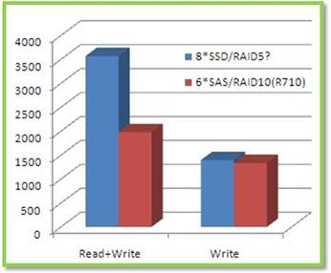
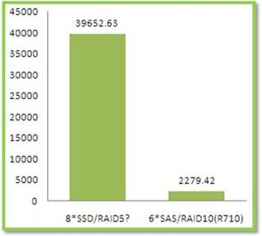
How Test
Sysbench
How to use sysbench
How many row
Read write rate

Slide 10
How Test
Why sysbench?
Why not sysbench?
Why supersmack?
Data set > 120G
95% query for 5%data
80% query for 20% data

Slide 11
How Test
Supersmack

Slide 12
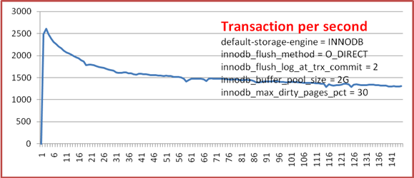
How Test
Supersmack
Dell PowerEdge 2950
Mem:24G 6*300 SAS RAID10
We test different PC Server/Hardware

Slide 13
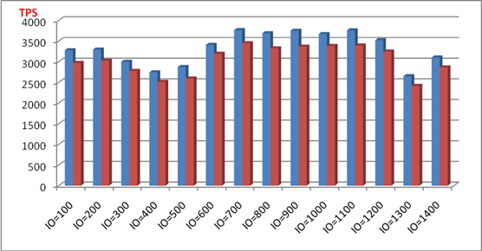
What Test
Decide which value we choose
InnoDB_IO_CAPACITY
One hour average in blue
Tow hour average in red

Slide 14
Install
Test Money Sysbench/supersmack
Install Time
Debug Stability
Backup Safety
>mysql_install_auto -h 172.23.119.257 -v 5.1.45
File descriptor
Swappiness
.......

Slide 15
Debug
It’s a real complicated work
One point: tcpdump + mk-query-digest
It’s a talent work

Slide 16
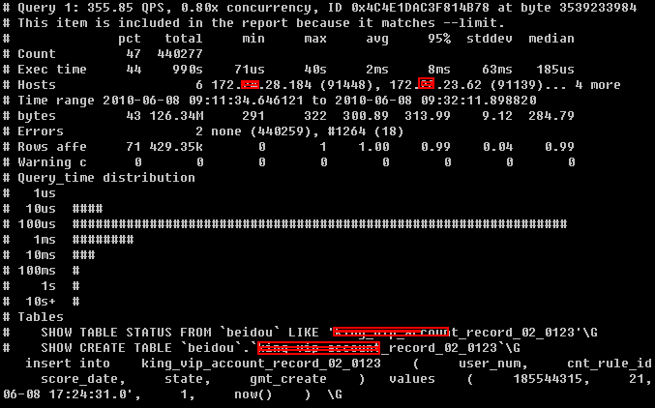
Debug
tcpdump + mk-query-digest

Slide 17
Backup
mysqldump is cool
39G .sql takes 80 min
Restore takes 206 min(3.4)
Still we need Xtrabackup
On line
No lock
Some environment
it’s quick && restore is quick

Slide 18
Xtrabackup
Using InnoDB Redo (Transaction log)
No effect to the Online system
Also help u to setup a new slave
System can be more Available

Slide 19
More backup strategy
Last 4 Day Last 3 month Last 3 Year
1 3 5 mysqldump 2 4 6 xtrabackup

Slide 20
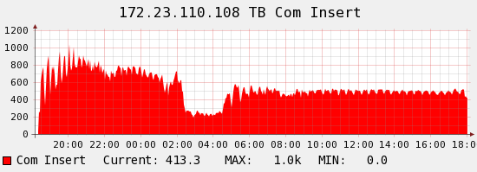
MySQL Monitor
Quick way: Cacit + RRDTool
Screenshot

Slide 21
What we monitor
Com_select
Com_insert
Com_update
Com_delete
Principle:
The bigger the system is,
the more simple the basic layer is
InnoDB
Logical read/write
Physical read/write
Row operation

Slide 22
Finally
Test Money Sysbench/supersmack
Install Time Linux/bash
Debug Stability mk-query-digest / iostat / ...
Backup Safety Xtrabackup
Monitor Status Cacti / RRDTool
Enjoy....

Slide 23

What I know is so limited
Still I like Sharing
Q & A

